Slide 1
Partitioning

Slide 2
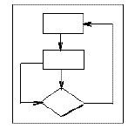
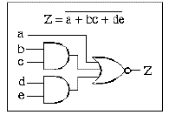
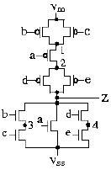
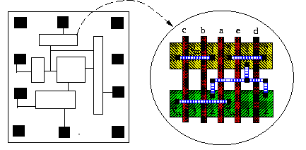
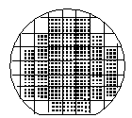

VLSI Design Flow
System Specification
functional simulation
specification
Function/architecture Design
logic simulation
behavioral representation
Logic Synthesis
circuit analysis
structural representation
Circuit Design
extraction & verification
structural representation
Physical Synthesis
physical representation
Fabrication
Packaging

Slide 3
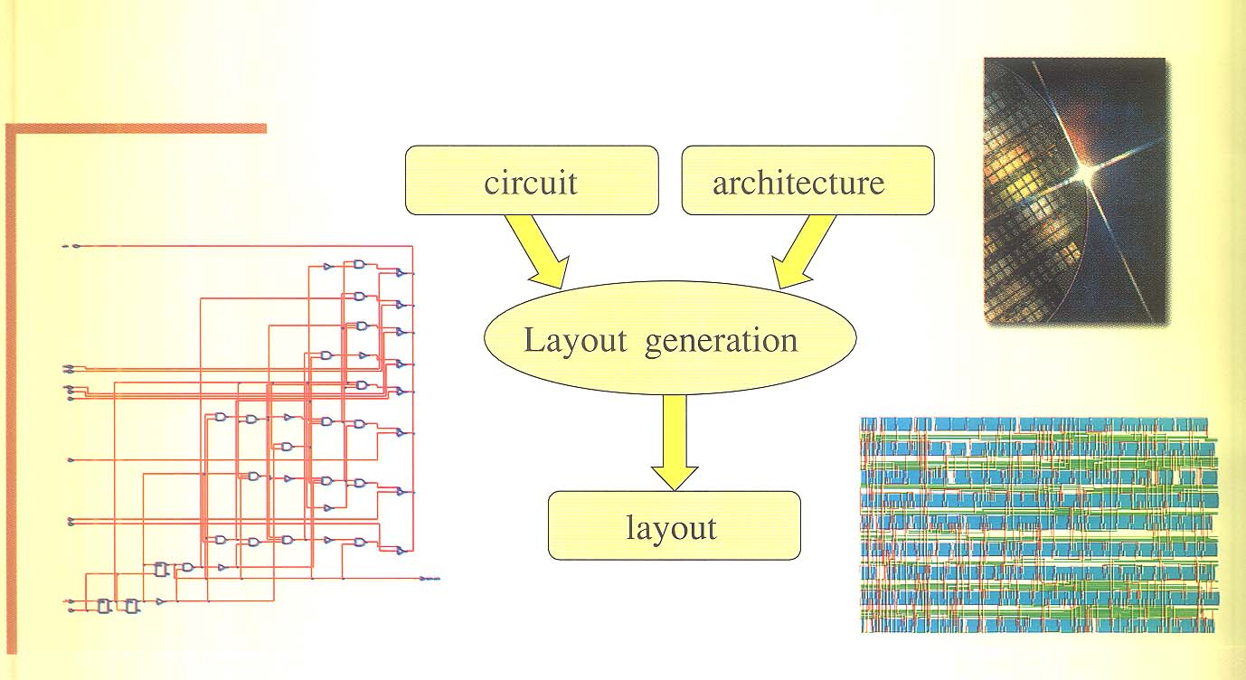
Physical Design

Slide 4
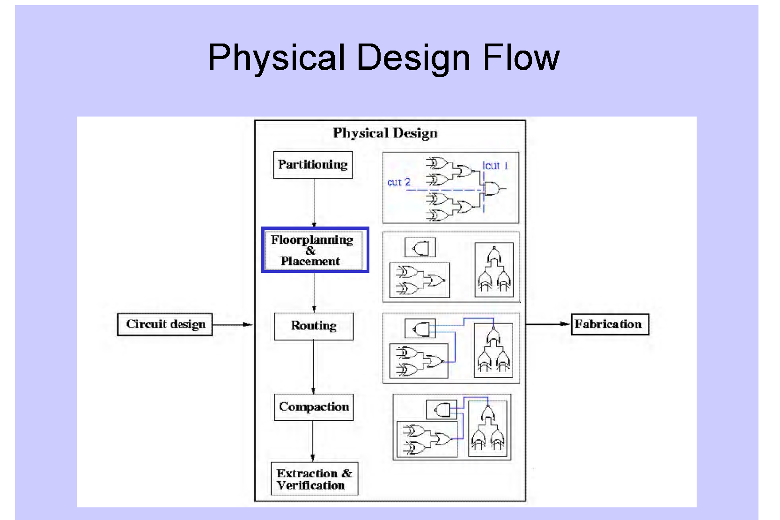

Slide 5
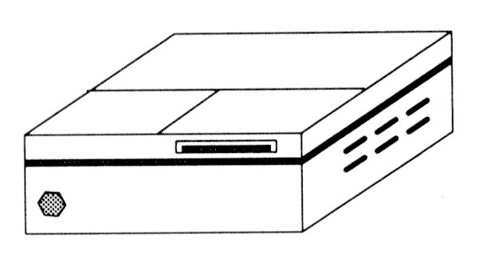
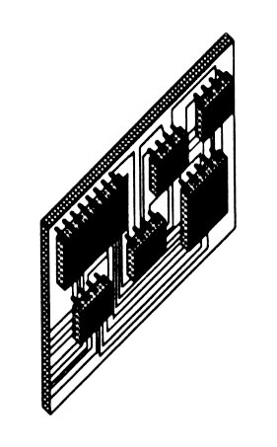
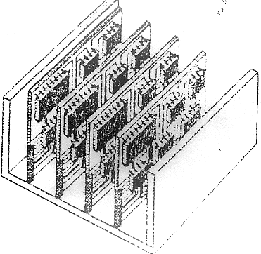
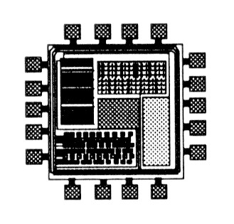
Circuit Partitioning

Slide 6
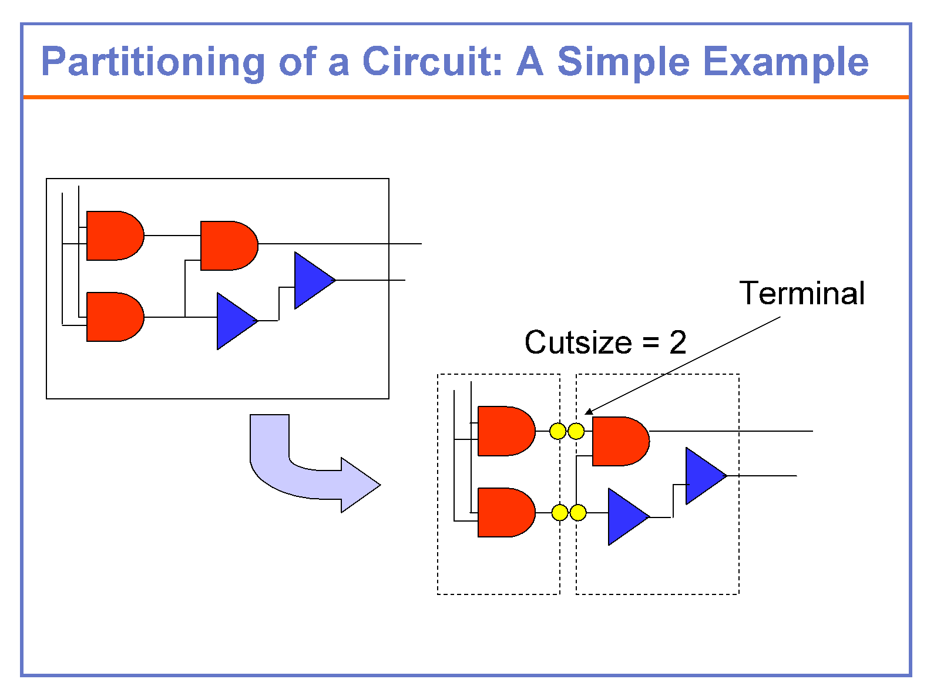

Slide 7
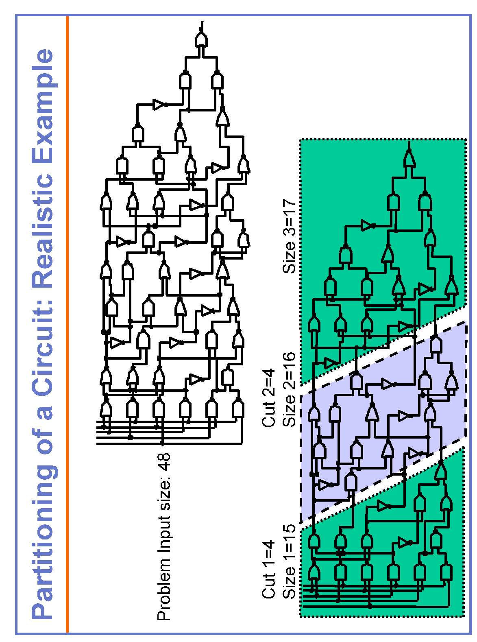

Slide 8
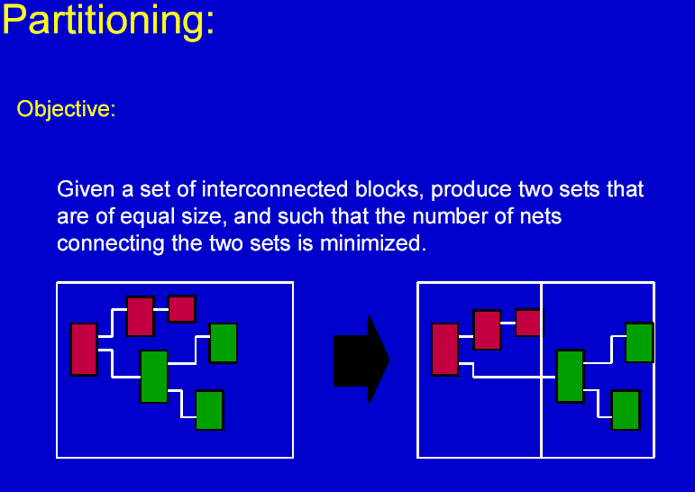

Slide 9
Why Partitioning?
Partitioning-The process of decomposition of a large system into independent manageable subsystems.
Why partition a circuit ?
•Complex system with a large number of components
•Efficient design by breaking into smaller subsystems
•Each subsystem can be designed independently and concurrently
•Decompose the system so as to preserve the original functionality
•Minimize interface across the partition
•Time for decomposition should be small
The Goal: To improve the circuit performance and reduce the layout cost

Slide 10
Partitioning
•Decomposition of a complex system into smaller subsystems
–Done hierarchically
–Partitioning done until each subsystem has manageable size
–Each subsystem can be designed independently
•Interconnections between partitions minimized
–Less hassle interfacing the subsystems
–Communication between subsystems usually costly

Slide 11
Hierarchical Partitioning
•Levels of partitioning:
–System-level partitioning:
Each sub-system can be designed as a single PCB
–Board-level partitioning:
Circuit assigned to a PCB is partitioned into sub-
circuits each fabricated as a VLSI chip
–Chip-level partitioning:
Circuit assigned to the chip is divided into
manageable sub-circuits
NOTE: physically not necessary

Slide 12
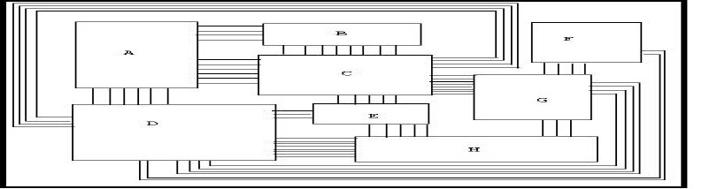

VLSI Layout can be represented by a graph
VLSI Layout
Graph Representation

Slide 13
Circuit Partitioning: A Graph-Theoretic Problem
1
5
1
5
2
6
2
6
cut cost = 1
3
7
3
7
4
8
4
8
cut cost = 9

Slide 14
Circuit Partitioning Complexity
For 2n circuit nodes, # of possibilities = (^{2n})
For a 100-gate circuit, there are 5 ×10²⁸ possibilities;
It will take around 1.59 x 10¹³ years if one checks
100 M possibilities per second.
_{n}

Slide 15
Graphs and Hypergraphs
The input Circuit of a VLSI Physical Design problem is a hypergraph
a
Hyperedge
d
h
b
b
g
c
e
a
f
d
e
f
Graph
c
Hypergraph

Slide 16
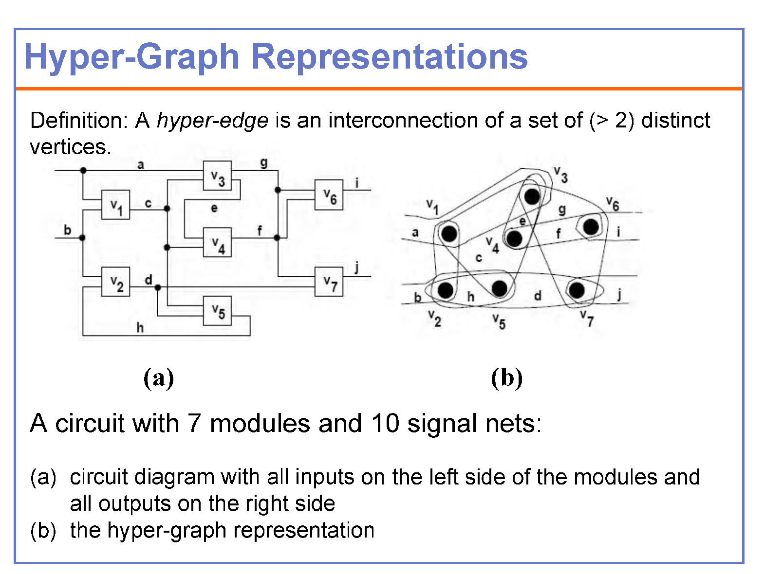
It is difficult to design efficient algorithms based on hypergraph

Slide 17
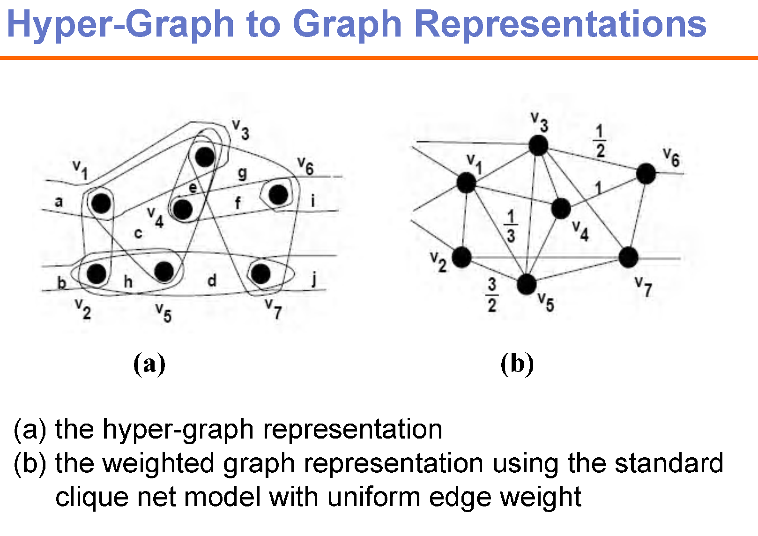
Several algorithm exist to represent hyperedges with graph edges, but most effective one is still unknown

Slide 18
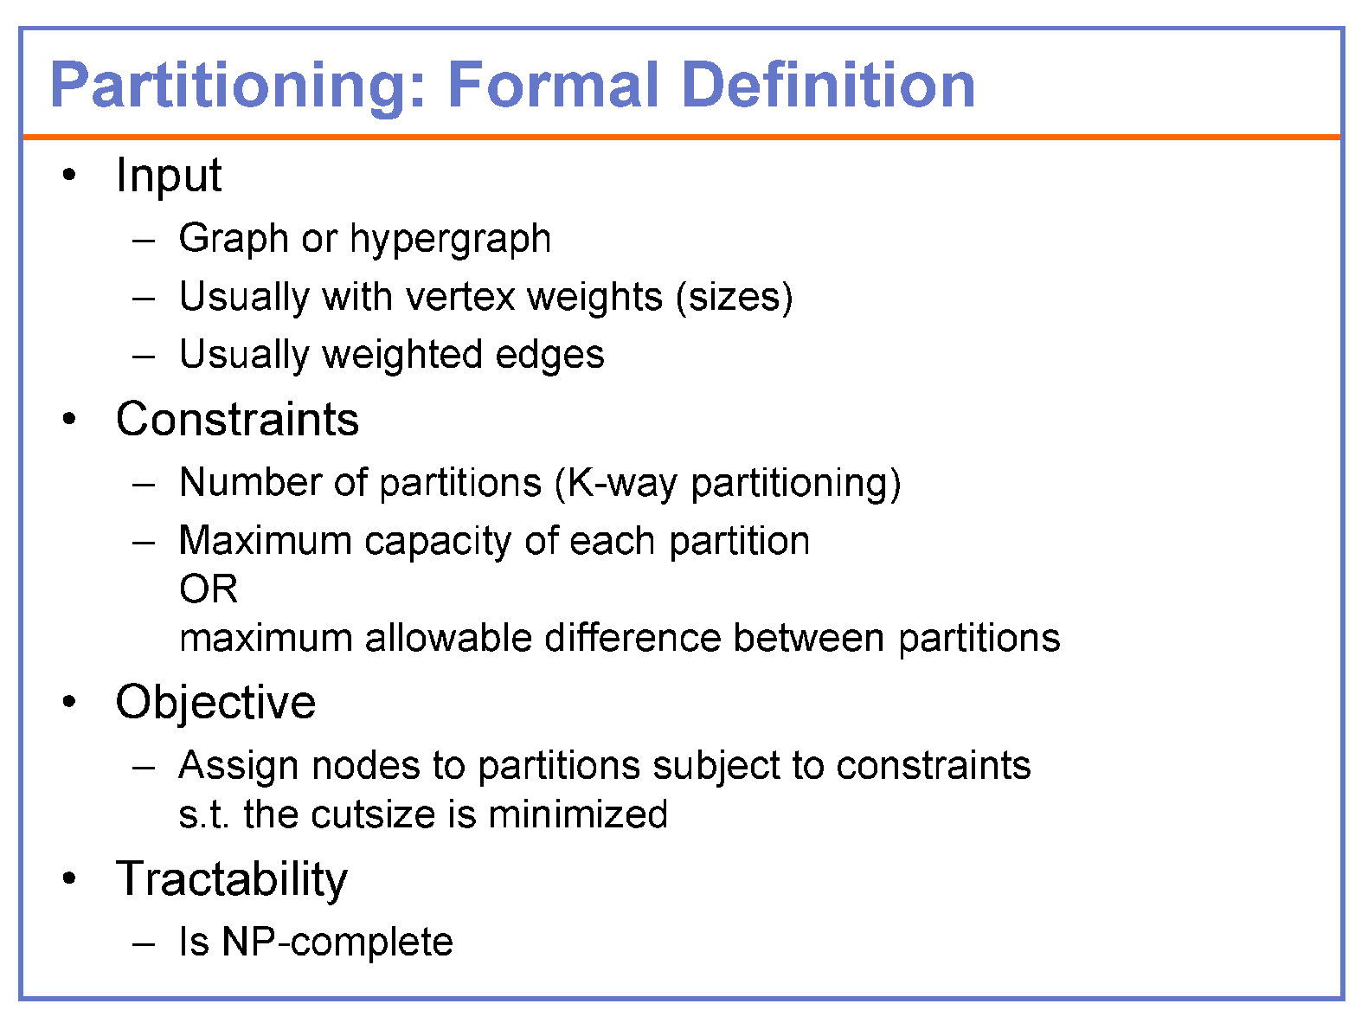

Slide 19
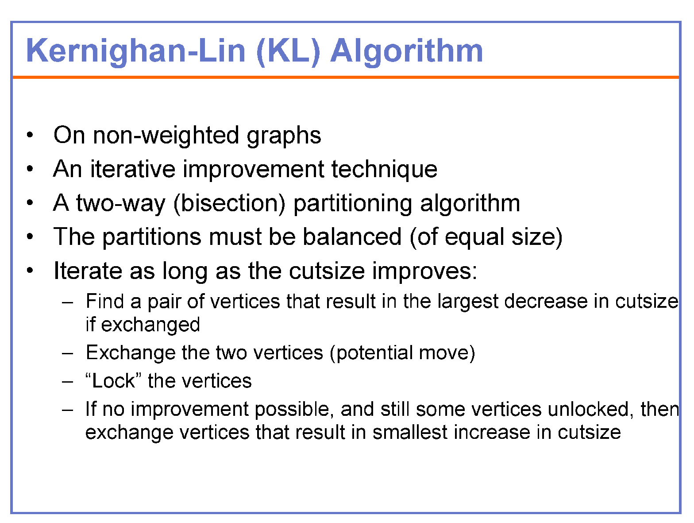

Slide 20
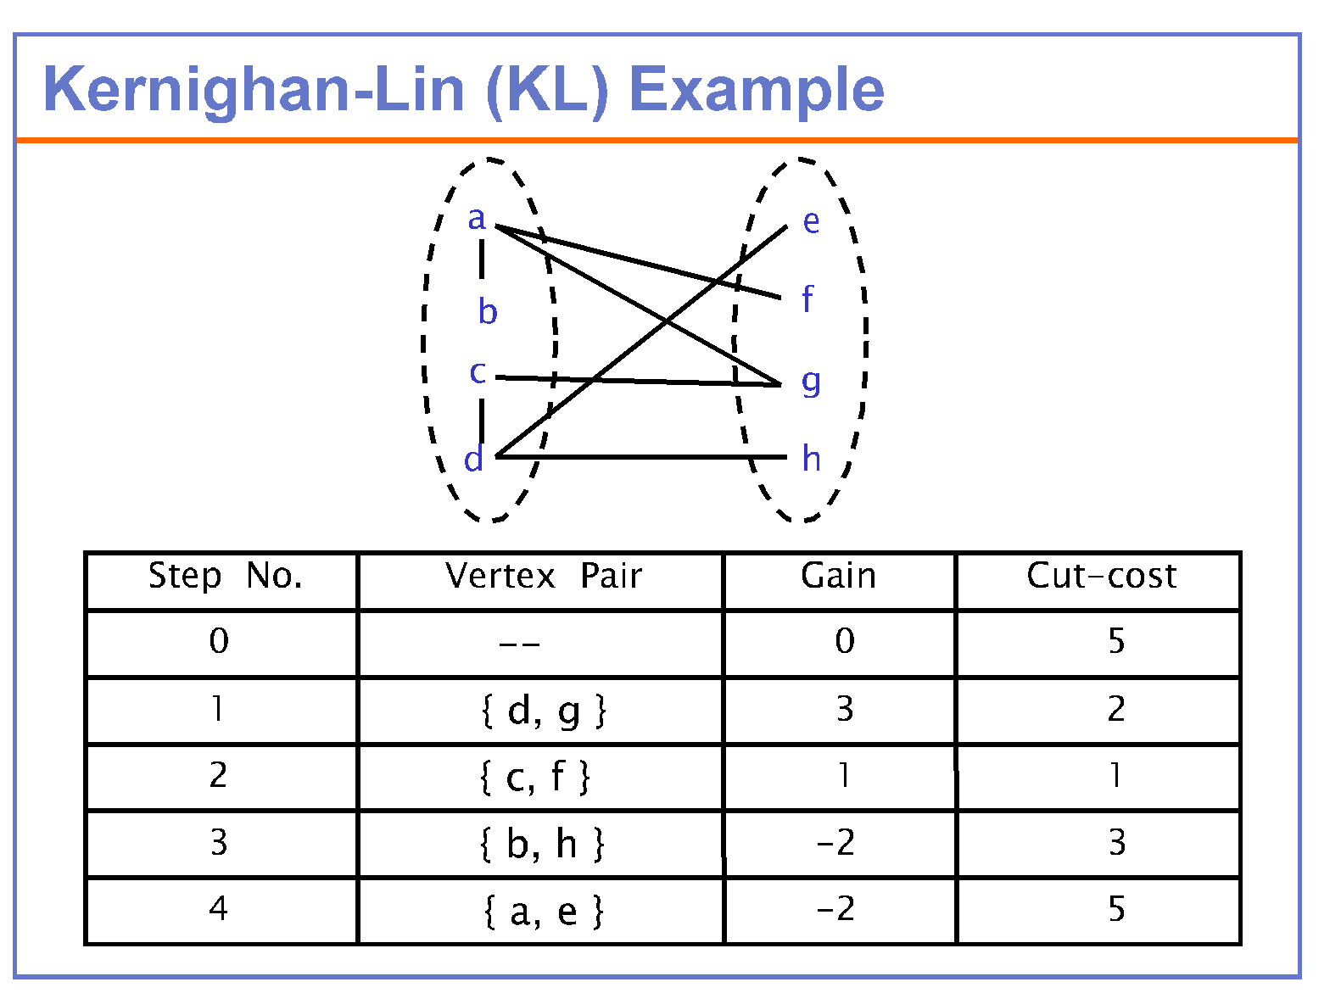

Slide 21
Kernighan-Lin (KL) Algorithm
•Initialize
–Bipartition G into V₁and V₂, s.t., |V₁| = |V₂| ±1
–n = |V|
•Repeat
–for i=1 to n/2
•Find a pair of unlocked vertices v_{ai}∈V₁ and v_{bi}∈V₂ whose exchange makes the largest decrease or smallest increase in cut-cost (gain)
•Mark v_{ai} and v_{bi} as locked
•Store the gain g_{i}.
–Find k, s.t. Σ_{i=1..k} g_{i}=Gain_{k} is maximized
–If Gain_{k}> 0 then
move v_{a1},...,v_{ak} from V₁ to V₂ and v_{b1},...,v_{bk} from V₂ to V₁.
•Until Gaink≤0

Slide 22
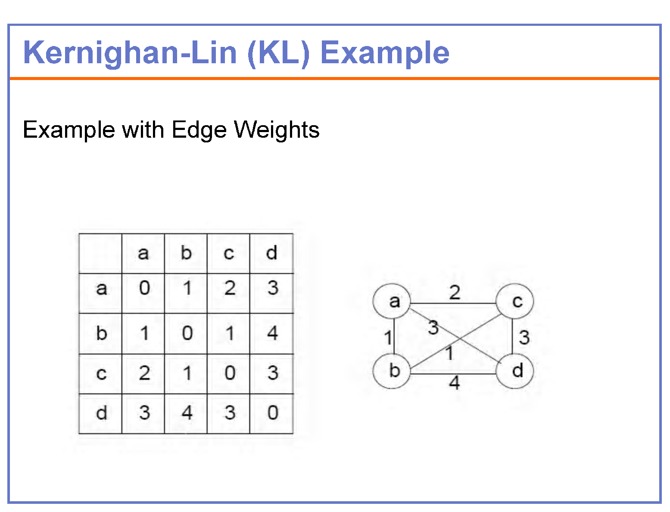

Slide 23
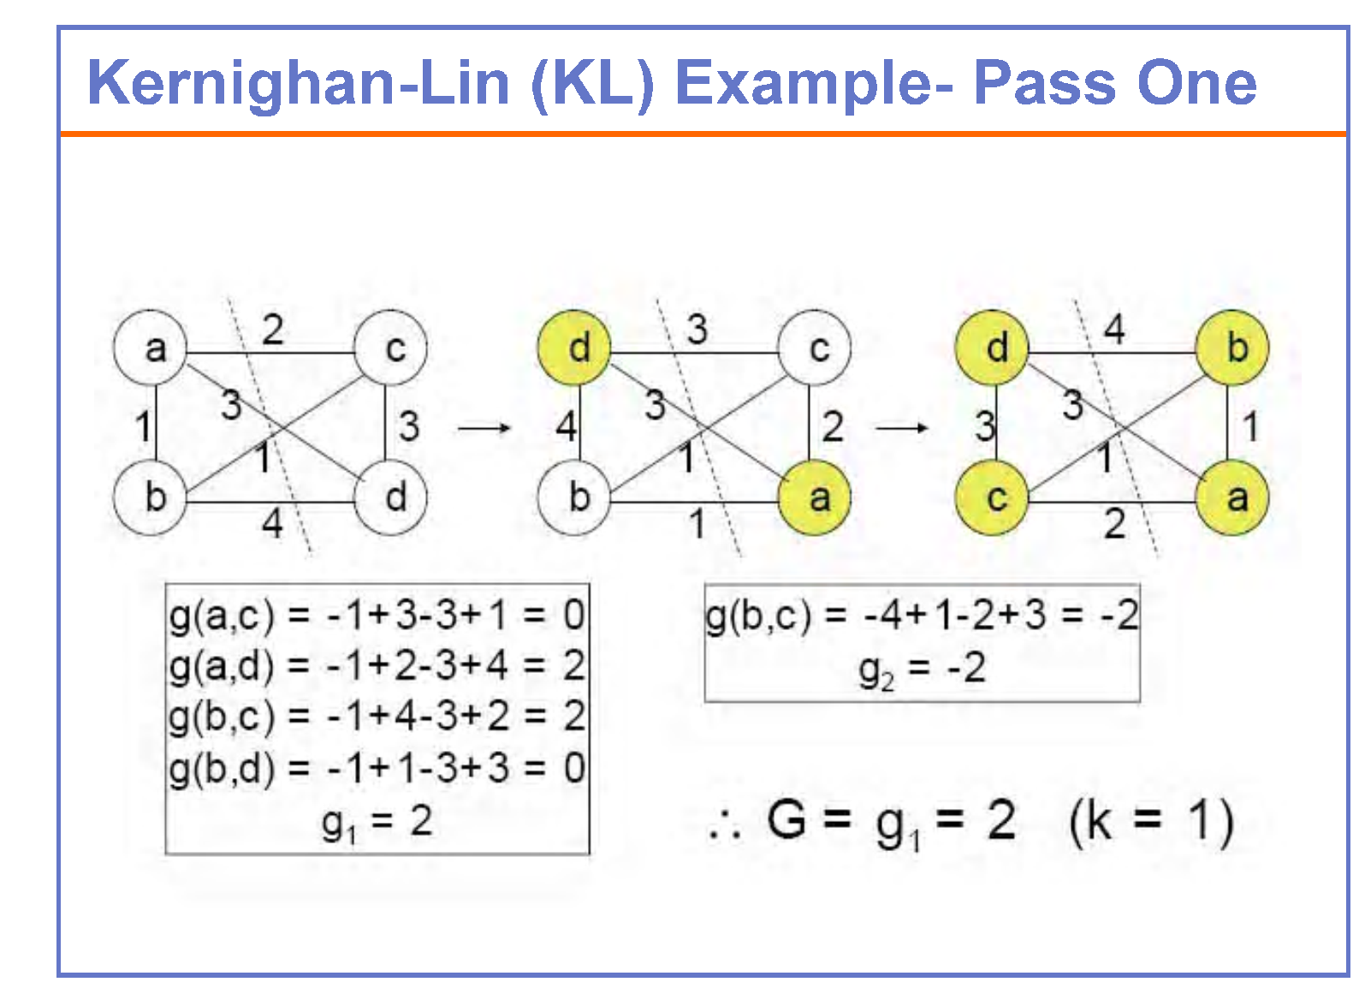

Slide 24
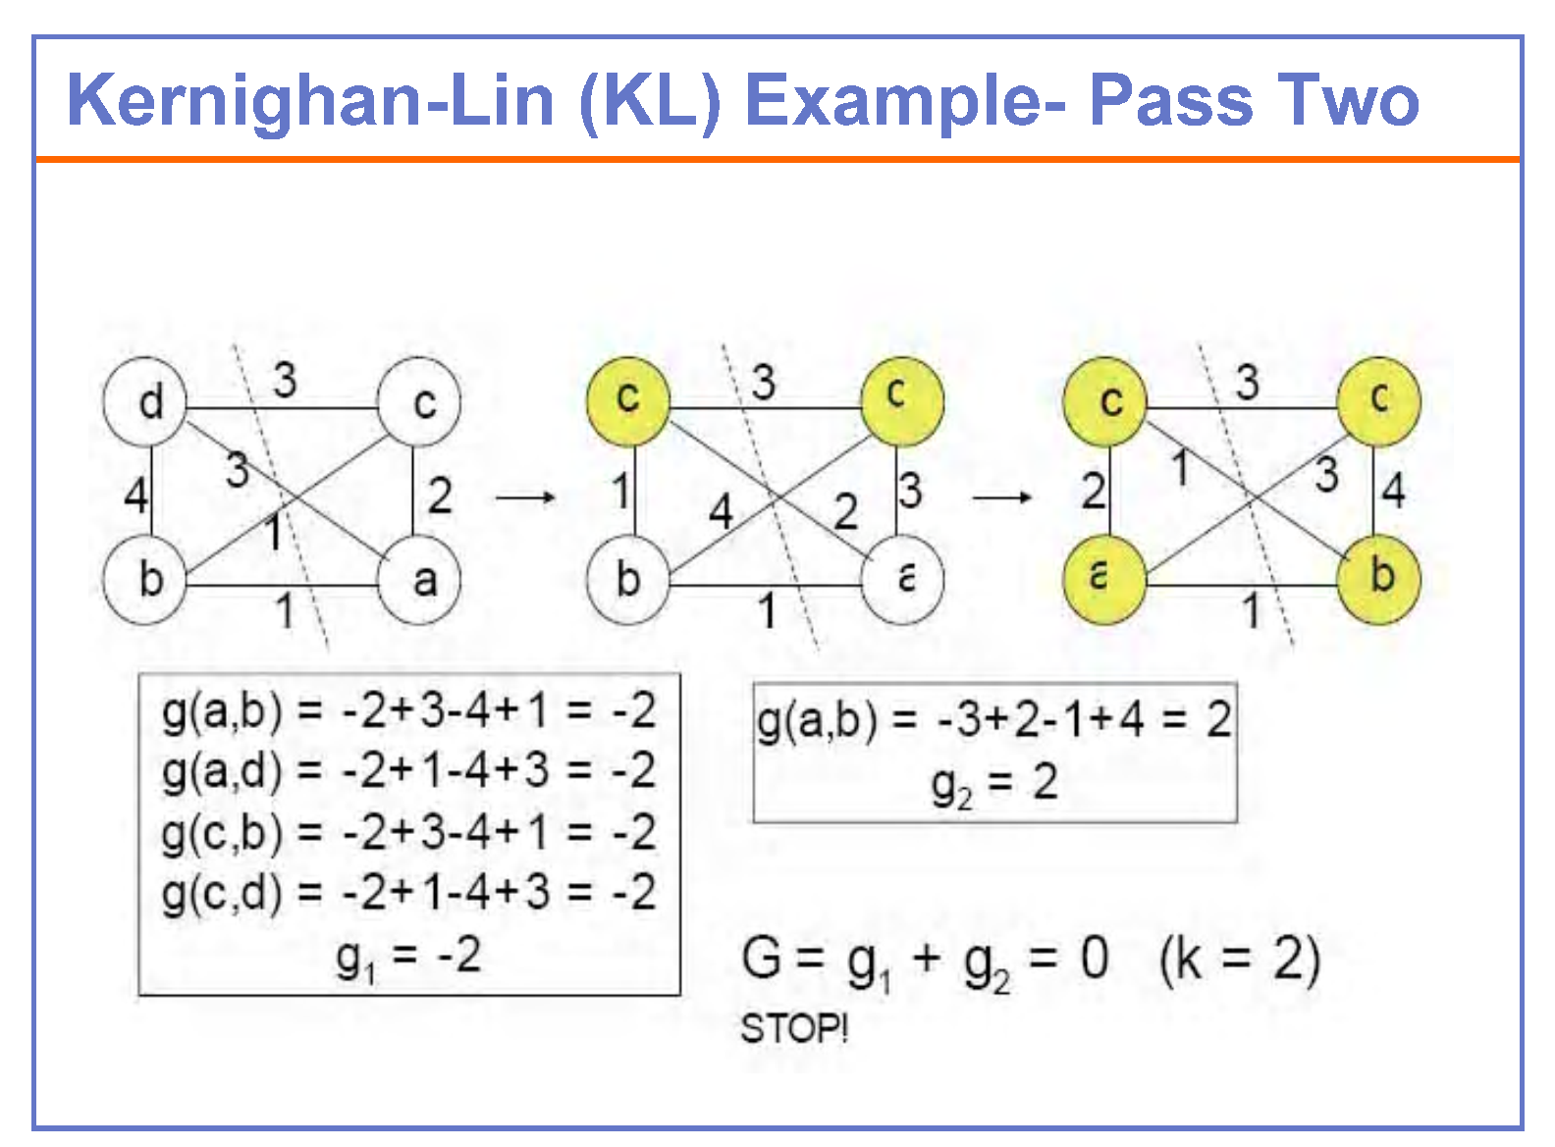

Slide 25
Kernighan-Lin (KL) Algorithm: Time Complexity
•Initialize –Bipartition G into V₁and V₂, s.t., |V₁| = |V₂| ±1
–n = |V|
•Repeat –for i=1 to n/2
•Find a pair of unlocked vertices v_{ai}∈V₁ and v_{bi}∈V₂ whose exchange makes the largest decrease or smallest increase in cut-cost (gain)
•Mark v_{ai} and v_{bi} as locked
•Store the gain g_{i}.
–Find k, s.t. Σ_{i=1..k} g_{i}=Gain_{k} is maximized
–If Gain_{k}> 0 then
move v_{a1},...,v_{ak} from V₁ to V₂ and v_{b1},...,v_{bk} from V₂ to V₁.
•Until Gaink≤0
–Inner (for) loop
•Iterates n/2 times
•Iteration 1: (n/2) x (n/2)
•Iteration i: (n/2 –i + 1)².
–Passes? Usually independent of n
–O(n³)

Slide 26
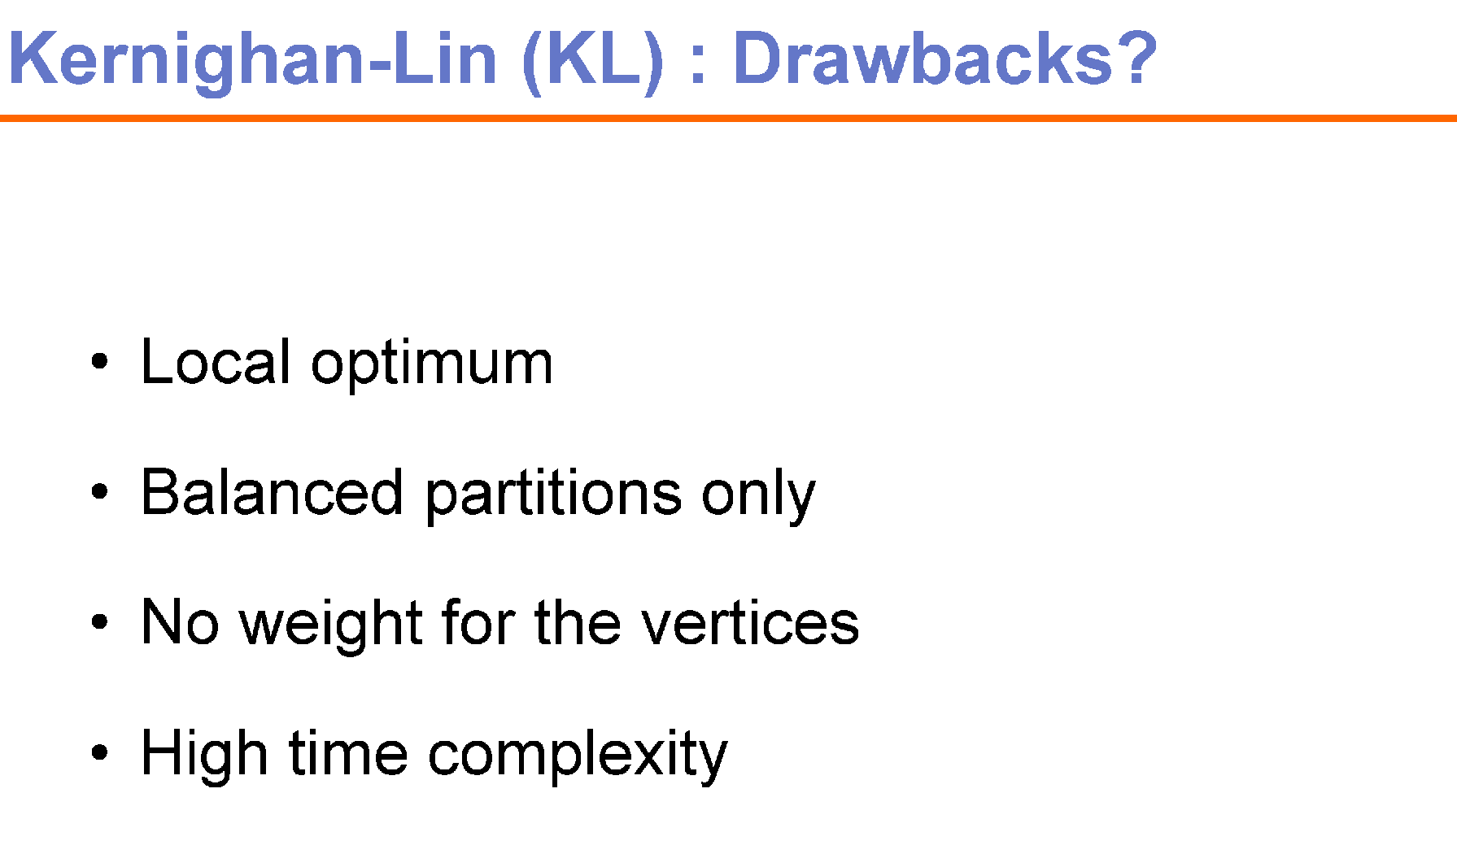
Difficult to tackle the problems of Hyper-edges and weighted edges

